Slide 1

Project Plan – EVT - CES
CIT – 41200 - 20014
Team ORANGE

Slide 2
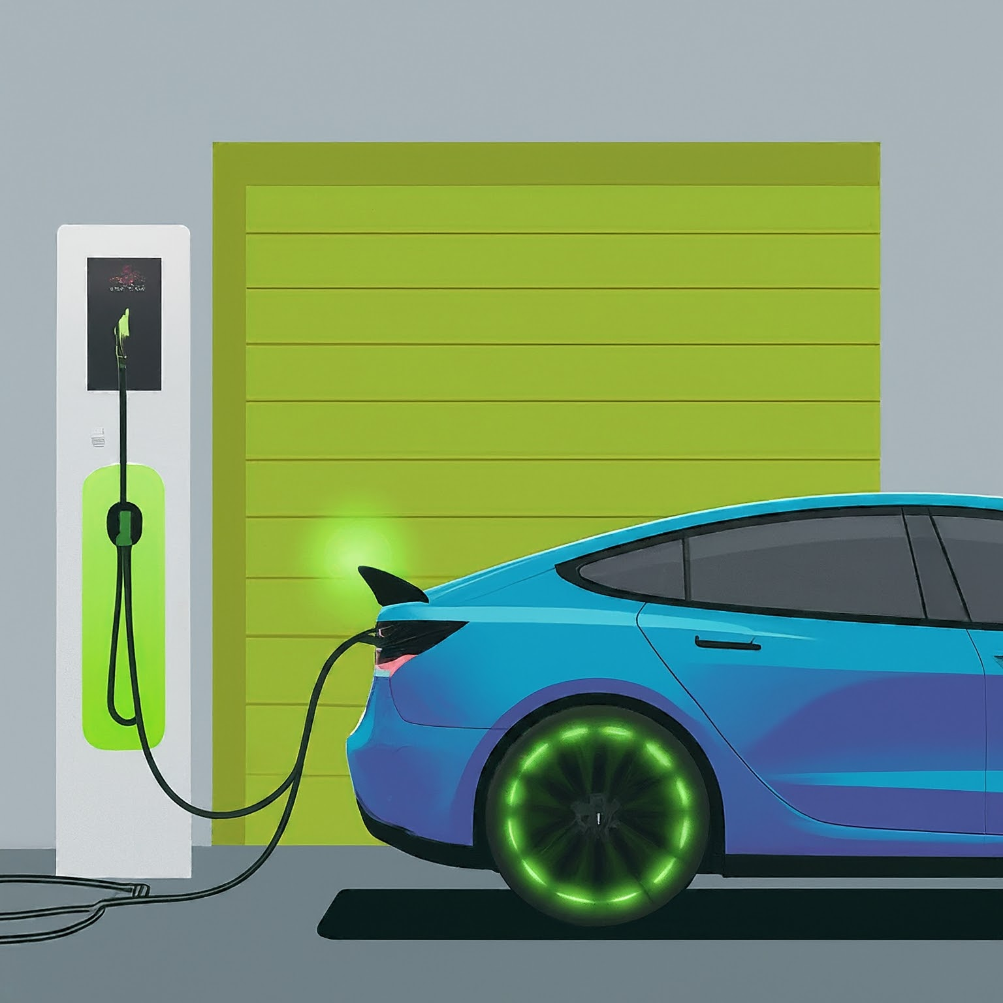
Project Description
TOPIC
Electric Vehicle Tax Credit Eligibility System (EVT-CES)
DESCRIPTION
EVT-CES is a web-based application that leverages MongoDB and BigQuery to provide users with detailed information on electric vehicles (EVs), focusing on their eligibility for tax credits under the Inflation Reduction Act. It assesses vehicles based on manufacturing location, battery production, and sourcing of critical minerals, offering an invaluable tool for consumers seeking eco-friendly transportation options that qualify for financial incentives.

Slide 3







What Problem does this Application Solve?
BEFORE APPLICATION
Users had to ask dealers about whether a new car they would like to purchase qualifies for EV Tax credits.
Car Dealership
Give Car Form
Dealer Verifies
Customers
AFTER NEW APPLICATION
The application will make the process simpler for the user by allowing them to input details from the manufacturers document.
Customers/Users
Documents
EV Tax Credit Result

Slide 4








Technology Stack
1.
2.
3.
4.
HTML
CSS
JAVASCRIPT
NODE.JS
5.
6.
7.
8.
MONGODB
BIGQUERY
GOOGLE MAPS
REACT

Slide 5










Team Member Skillsets
Shail
Suhaib
Areeb
Mohammed
WEB
UI
Database Expert
React Expert
Web – Dev Expert
React Expert

Slide 6
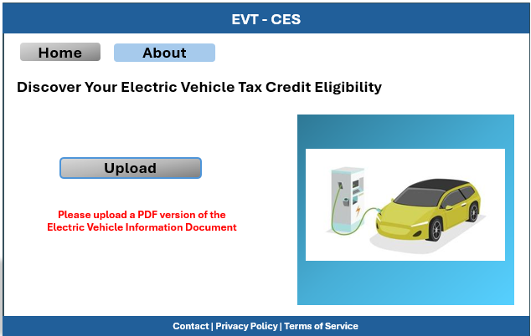
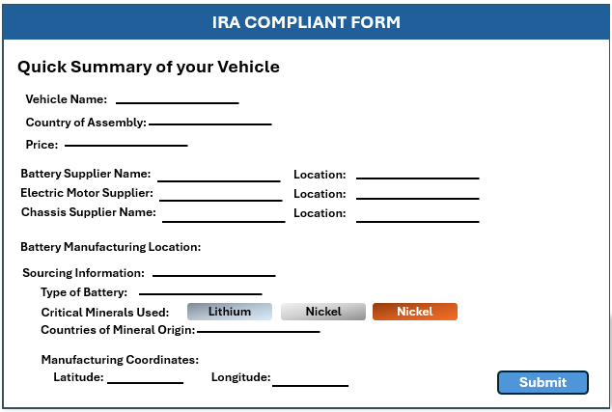
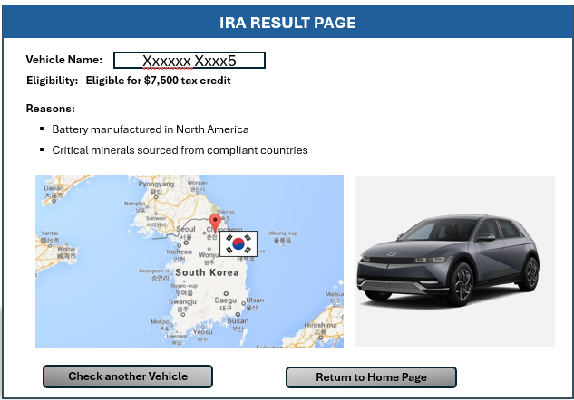





Project Architecture - Version 1.0
Google Cloud Shell
Landing Page
Form Page
Form Result Page
React and Node.JS development
React front – end with JS Logic to route to Form Page
React front–end with JS Form handling, Cloud Functions Trigger
React front–end with JS Logic to display results and Google Maps Integration
Google Cloud Function #1 (processEligibilty for tax credit eligibility
App Engine
(Hosting for Node.js Server
And React Front – End App)
Secure API
handles authentication
Data validation, and secure
communication with
cloud function
Google Cloud Function #2
mapVehicleOrigin
For mapping vehicle assembly location.
MongoDB
(Database for storing and updating vehicle data)
{MongoDB}
BigQuery
Analytical queries and storing processed data for analytics)

Slide 7



Two Google Cloud Functions
processEligibility
mapVehicleOrigin

Slide 8
Project Development File Structure
React Front - End
CSS
Landing Page:
- LandingPage.js (React component)
- LandingPage.css (styling for the Landing Page)
Shared Styles:
App.css (general styles that apply to the whole application)
Form Page
Javascript
- FormPage.js (React component)
- FormPage.css (styling for the Form Page)
VehicleService.js (for handling API calls related to vehicles)
EligibilityService.js (for processing eligibility logic on the frontend)
Form Result Page
- FormResultPage.js (React component)
- FormResultPage.css (styling for the Form Result Page)
Cloud Function & Secure API
In this setup, the Secure API receives the data from the front end, and validates and authenticates it, then calls the Cloud Function via HTTP and waits for the result to be sent back to the front end.
Node.js Backend
Main Entry Point:
- index.js (the main server file that sets up the server and routes)
Shared
Main React Application File:
App.js (central React component that contains the routing logic)

Slide 9

Project Sprint Planning
Apr 8 – Apr 14
Apr 15 – Apr 21
Apr 22 – Apr 28
Apr 29 – May 1
SPRINT 1
SPRINT 2
SPRINT 3
SPRINT 4
Sprint 1: SETUP
Sprint 2: Feature Development
Sprint 3: Testing & Refinement
Sprint 4: Finalization & Deployment
Setup: Initialize project management on MS Teams, repositories, dev environments.
Begin backend development: Node.js API setup, MongoDB schema design.
Frontend: Start building HTML/CSS/JavaScript interface.
Backend: Integrate Google Maps API, develop Cloud Functions.
Database: Connect Node.js with MongoDB and BigQuery.
Testing: Conduct unit and integration testing.
Refinement: Enhance UI/UX, improve features based on feedback.
In-progress demo preparation.
Final Testing: Stress test and user acceptance testing (UAT).
Deployment: Launch on Google Cloud Platform
Documentation and final touches for project submission.

Slide 10





Potential Project Risks & Mitigation Planning
Cost Management
Risk: Utilizing cloud resources and external APIs can lead to unexpected costs, especially if the application experiences a high volume of traffic or data processing.
Mitigation: Monitor usage and set up alerts for billing thresholds. Optimize resource usage and query efficiency. Consider implementing quotas or rate limiting for API usage.
Data Accuracy & Integrity
Risk: Incorrect or outdated vehicle and supplier data can lead to wrong eligibility determinations, affecting user trust.
Mitigation: Implement validation checks and allow for regular updates to the vehicle and supplier data. Consider sourcing data from reliable and authoritative sources.
User Experience
Risk: A poor user interface or complex user interactions can deter users from effectively using the system.
Mitigation: Invest in UI/UX design, conduct user testing to gather feedback, and iterate on the design to improve usability.

Slide 11
npm install react react-dom
APIs that will be utilized in the Project
1.
Google Maps Javascript API
2.
Google Cloud BigQuery
npm install @google-cloud/maps
npm install --save @google-cloud/bigquery
3.
MongoDB
4.
Express.js
npm install mongodb
npm install express
Additional Dependencies
npm install body-parser
npm install cors
npm install react react-dom

Slide 12









Team Task Tracking
Burndown Charts
GitHub
Weekly Reviews
(Document Collaboration)
Task Breakdown
Bi – Weekly Meetings
(Real Time Communication)
Skill Expertise
MS Teams Chat
(Asynchronous Communication)
Excel Documentation
(Task Managemnent & Tracking)

Slide 13
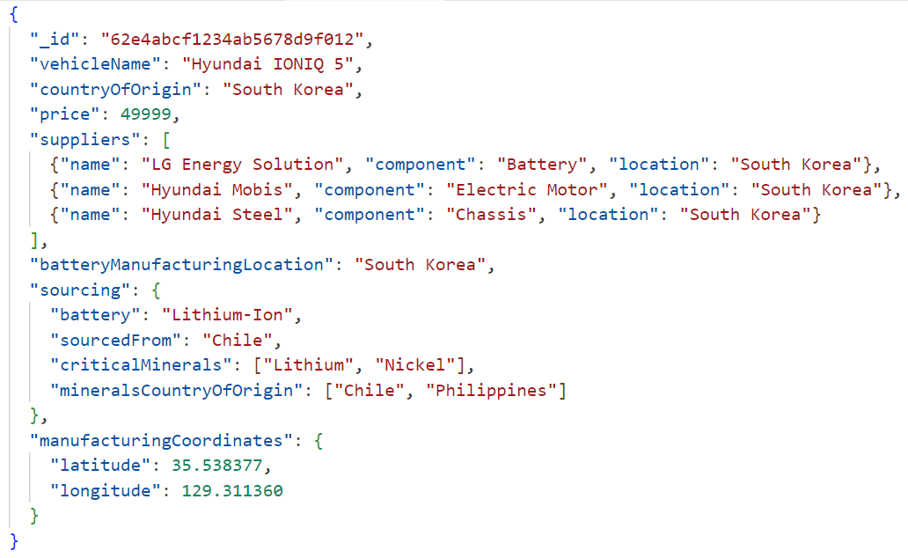










Sample MongoDB Document
Vehicle Name
Price
Vehicle Assembly Location
Battery Assembly
Electric Motor Assembly
Plant
Chassis Assembly
Sourcing
Currently, the EV Battery data source is not available, so the data needs to be constructed for the application.
Plant Coordinates
NoSQL (MongoDB Data will be developed by the team) EXTERNAL DATA SOURCE WILL NOT BE USED

Slide 14


Sample Landing Page UI Design
Simple Design = Less Lead Time
EVT - CES
Home
About
Discover Your Electric Vehicle Tax Credit Eligibility
Upload
Please upload a PDF version of the Electric Vehicle Information Document
Contact | Privacy Policy | Terms of Service

Slide 15
Form Page Sample UI Design
Simple Design = Less Lead Time
IRA COMPLIANT FORM
Quick Summary of your Vehicle
Vehicle Name:
Country of Assembly:
Price:
Battery Supplier Name:
Location:
Electric Motor Supplier:
Location:
Chassis Supplier Name:
Location:
Battery Manufacturing Location:
Sourcing Information:
Type of Battery:
Critical Minerals Used:
Lithium
Nickel
Nickel
Countries of Mineral Origin:
Manufacturing Coordinates:
Latitude:
Longitude:
Submit

Slide 16



Result Page (Final Website Page)
Simple Design = Less Lead Time
IRA RESULT PAGE
Vehicle Name:
Xxxxxx Xxxx5
Eligible for $7,500 tax credit
Eligibility:
Reasons:
Battery manufactured in North America
Critical minerals sourced from compliant countries
Check another Vehicle
Return to Home Page

Slide 17




Visual Process Diagram
User uploads a PDF of the Electric Vehicle Details Document
The user gets a Quick Summary of the Electric Vehicle Details. The user needs to click on the Submit Button
Javascript Logic calculates whether an EV qualifies for the tax credit. The user gets report including Assembly Plant Location
BigQuery Stores Relational Database Details for Data Collection
TAX ID
VIN
MANUFACTURER
MODEL
YEAR
ELIGIBILITY
MongoDB Document Generated

Slide 18
THANK YOU

